Slide 1
FUNCTIONS

Slide 2
Definition:
A function is a set of statements that ; take inputs , perform some computations and then produces output.
Syntax: Return_type function_name(set_of_inputs)
Return Type → Indicates the type of output returned by the function
Function Name → Is the name of the function (a descriptive name to tell us what the function does)
Set of inputs → these are inputs provided to the function.

Slide 3
#include <stdio.h>
int areaofRect(int length , int width ) //function declaration
{
int area ;
area = length * width ;
return area ;
}
int main( )
{
int length = 5 , width = 4 ;
int area = areaofRect(5 , 4) ; //function call or invocation
printf(“ The area is : %d\n ” , area );
}

Slide 4
Why Functions ?
Re – Usability : Once defined functions can be used again and again and again instead of writing fresh code all the time. Thus are an effiecient way to perform ceartain computations I your code.
Abstraction : Functions add a layer of abstraction to our work and save us the complexity if having to write tons of code and have to know how everything works under the hood.

Slide 5
Function Declaration
Function declaration (Also called function prototype) means :
declaring the properties of a function to the compiler.
Eg : int scores(int , char )
Properties:
1. Function name : Scores
2. Function Return Type : int
3. Number of Parameters : 2
4. Type of Parameter 1 : int
5. Type of Parameter 2 : char

Slide 6
* NOTE * it’s not a must to write the names of your parameters in function declaration / prototype. You can just put the data type and it will still be correct.
Eg : int areaofRect(int length , int width );
int areaofRect(int , int );
So what happens when you call a function before you do your function declaration ?
→ You will get an implicit declaration error
→ also a conflicting types error.

Slide 7
Function Definition
This is the block of code that is capable of performing specific tasks.
Eg : our function below performs the sum of two integers
int add(int a , int b)
{
int sum ;
sum = a + b ;
return sum ;
}

Slide 8
  Int add(int , int ); //function prototype/function declaration
  int main ( )
  {
  int m = 20 , n = 30 , sum ;
  sum = add (m , n) ; //function call using arguments
  printf(“sum is %d \n “ , sum) ;
  }
  int add (int a , int b) //function definition and parameters
  {
  return (a + b ) ;
  }

Slide 9
C Header Files
A header file is a file with extension .h which contains C function declarations and macro definitions to be shared between several source files.
You request to use a header file in your program by including it with the C preprocessing directive #include.
A simple practice in C or C++ programs is that we keep all the constants, macros, system wide global variables, and function prototypes in header files and include these header files wherever it is required.
There are two types of header files:
1.Pre-existing header files: Files which are already available in C/C++ compiler we just need to import them.
2.User-defined header files: These files are defined by the user and can be imported using “#include”..
So you can write your own header file , put all your function prototypes inside and using the #include you add it to your source file.

Slide 10
Difference between Parameters and Arguments
A parameter : is a variable in the definition and declaration of a function.
An argument : is the value of the parameter that gets passed to the function .
Next Concept :
CALL BY VALUE AND CALL BY REFERENCE

Slide 11
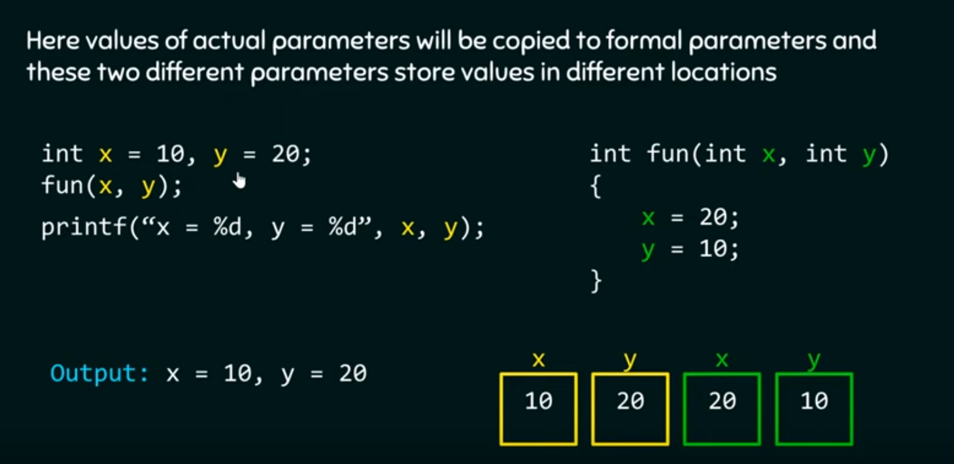
CALL BY VALUE
Call by value → The values of your actual parameters(arguments) are passed to your formal parameters and these two different parameters store values in different locations.
So in call by value you are passing the value of your variables not the variable itself
Formal parameters behave like other local variables inside the function and are created upon entry into the function and destroyed upon exit.

Slide 12
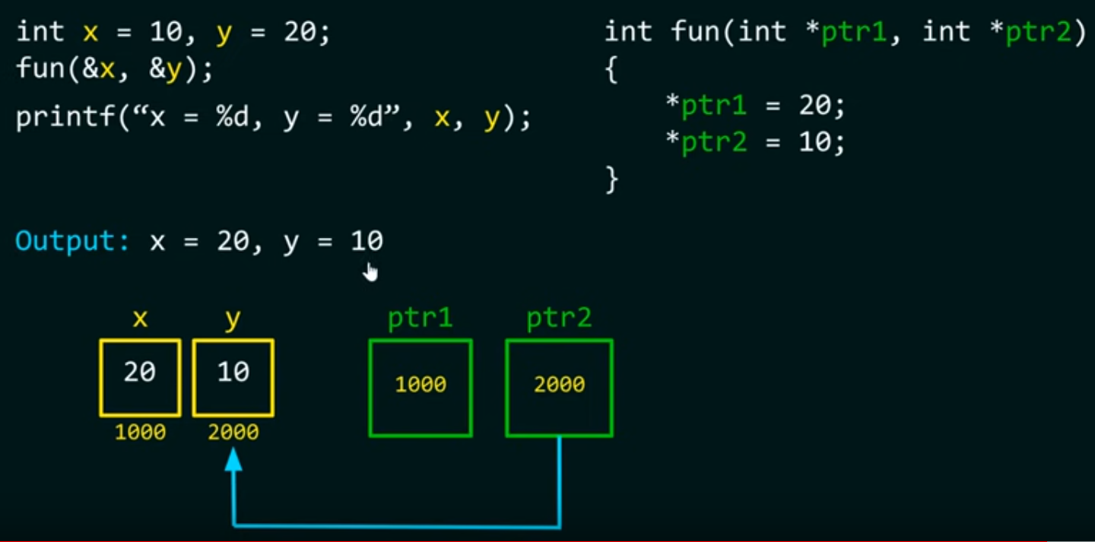
CALL BY REFERENCE
Here both actual and formal parameters refer to the same memory location.
Instead of passing values , we pass addresses.

